Slide 1
LTI- IDAM & PAM Service Offering & Capability
Date: Nov 2021

Slide 2
IDM+IGA - Challenges to Growing Enterprise Business
De-Centralized
Identity
User Lifecycle
No Common Policy
No centralized Identity Store. No single system to manage complete Identity Life Cycle
Manually managing users and their access, hence no Real Time Joiner/Mover/Leavers Policy enforcement
No Common Policy followed, SOPs are not followed manually, no common policy maintained for account creation
User Life Cycle challenges
Orphan Account
Rubber stamping
Risk Scoring
Business Challenges
No proper Orphan account account management process, which leaves enterprise open for compromise
No proper Re-Certification rather doing Rubber Stamp way of Certifying user’s access
Limited Visibility on Expired Access, Generating Risk scope for many other behavior
Regulatory and Compliance
Policy Violation
Reporting
Attach Surface
Audit
No periodic reviews on service account passwords, making it more vulnerable for credential theft
Availability of mandatory Audit reports
Orphan Account report
Privileged account report, LCM report
Existence of dormant/Idle account, Policy regularisation increases the attack surface

Slide 3
LTI POV, IDAM Service Offering

Slide 4










LTI PoV on Digital Identity Services
LTI Digital Identity Analytics and Orchestration Platform
Orchestration | Analytics | Chatbot’s | Automation | Machine Learning | Dashboards
IAM Domains
Identity Administration | Adaptive Access Control and Sign On | Identity Governance | Privileged Identity Management | Adaptive Authentication
Consumer
Identity & Access
Management
DevOps Adoption
Enterprise Identity Management
Migrations
Technology Implementations
RPA Implementations
Cloud/Multi Cloud Use Case Implementations
Technology Migration
Application Integrations
Orchestration
Analytics
DevOps and
Bots
Cloud Identity
Bot Identity Management
Privileged Identity
RPA
API Management
IAM Platform Management
Manual Identity Operations
Automated Identity Operations
Strategy | Design | Implementation | Development| Operations
Technology Ecosystem
and many more….

Slide 5

LTI-Service Offerings towards Identity management
Advisory & Assessment
IDAM Strategy and Roadmap
1
2
Professional Service
IGA, SSO, MFA, PIM/PAM, CIAM Solutions implementation
COE setup for training, Certifications etc.
LTI’s
IDAM Service Portfolio
3
COE
4
Migration Service
Migration within and outside the tool
5
Managed Services
IGA Run Support 8x5, 16x5, 24x7
Notes:
Merge 8,9,11

Slide 6
LTI IAM Advisory service

Slide 7
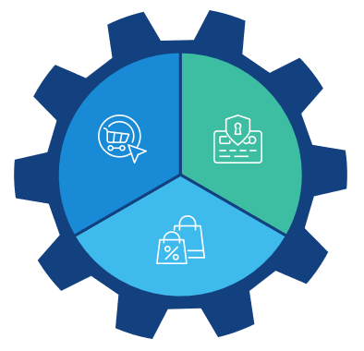
LTI IDAM Advisory Service Programs
LTI IAM Advisory Services
IAM insight
IAM Advisory Service
IAM Insight
Due Diligence
IAM Roadmap
IAM Process
Due Diligence
IAM Process
Vision
IAM Program
Vision
To be
Architecture
Program
To be
Architecture
LTI – Senior IGA Advisor
IAM Program
IAM Roadmap
3 Weeks – 3 Months
Strategy & Roadmap
3 Weeks – 3 Months
Scalable IDAM blueprint

Slide 8
Four Phased Approach – IGA Advisory Service
Current State
Analysis
IAM Strategy & Roadmap
Future State
Gap Analysis
Initial meeting to confirm objectives, scope, key stakeholders and engagement protocols
Obtain and analyze Current strategy, business and technical documentation, existing strategies, current architecture, security policies, SOPs.
Understand IAM projects scope and current technologies
Interviews with representatives to understand business priorities, expectations and critical information assets based on risks
Conduct workshops and interviews with controllers
Plan and conduct workshops and interviews with relevant stakeholders to understand customer’s strategic short & long terms goals
Define desired to be state IAM program by conducting interviews and workshops with representatives from business and technology functions
Target state architecture including desired state IDM capabilities
Provide the IG roadmap with new features addition with Risk based governance capabilities​
Provide the continuous governance use cases with respect to the current deployment state​
Define the application priority for the governance need ​
Provide Approach with the governance vs compliance needs basis on the gap analysis carried out in the previous phases ​
Understand the gaps that must be bridged based on the current and future state
Gap analysis on People, process and Technology
Comparison for Access for the Team members to meet continuous compliance ​
Verify the user access certification as periodic manner across the applications and perform rubber stamping for the access granted ​
Output
Business Case for Changes identified
Priorities definition, short term goal and long-term goal
Documented desired future state for Cybersecurity including:
Capabilities and maturity level
Dependencies, duplications or synergies between other roadmaps and initiatives
High level metrics and KPIs
Application categorization, integration strategies.
Basis on the application categories provide the report for the gap evolved in the existing governance ​
Strategize the governance cycle for the categorized applications for completing the governance process​
Current state document
Gap Analysis document
IGA program Roadmap
Business & Technical Requirements for the IAM Program
Application Categorization and Integration Approach
Technology Recommendation
Advisory Plan
Current State documentation:
Known issues, shortcomings, actions and quick wins
Understanding of threat and risks, challenges & trends
Summary report including current state analysis, risks, issues & Recommendations

Slide 9
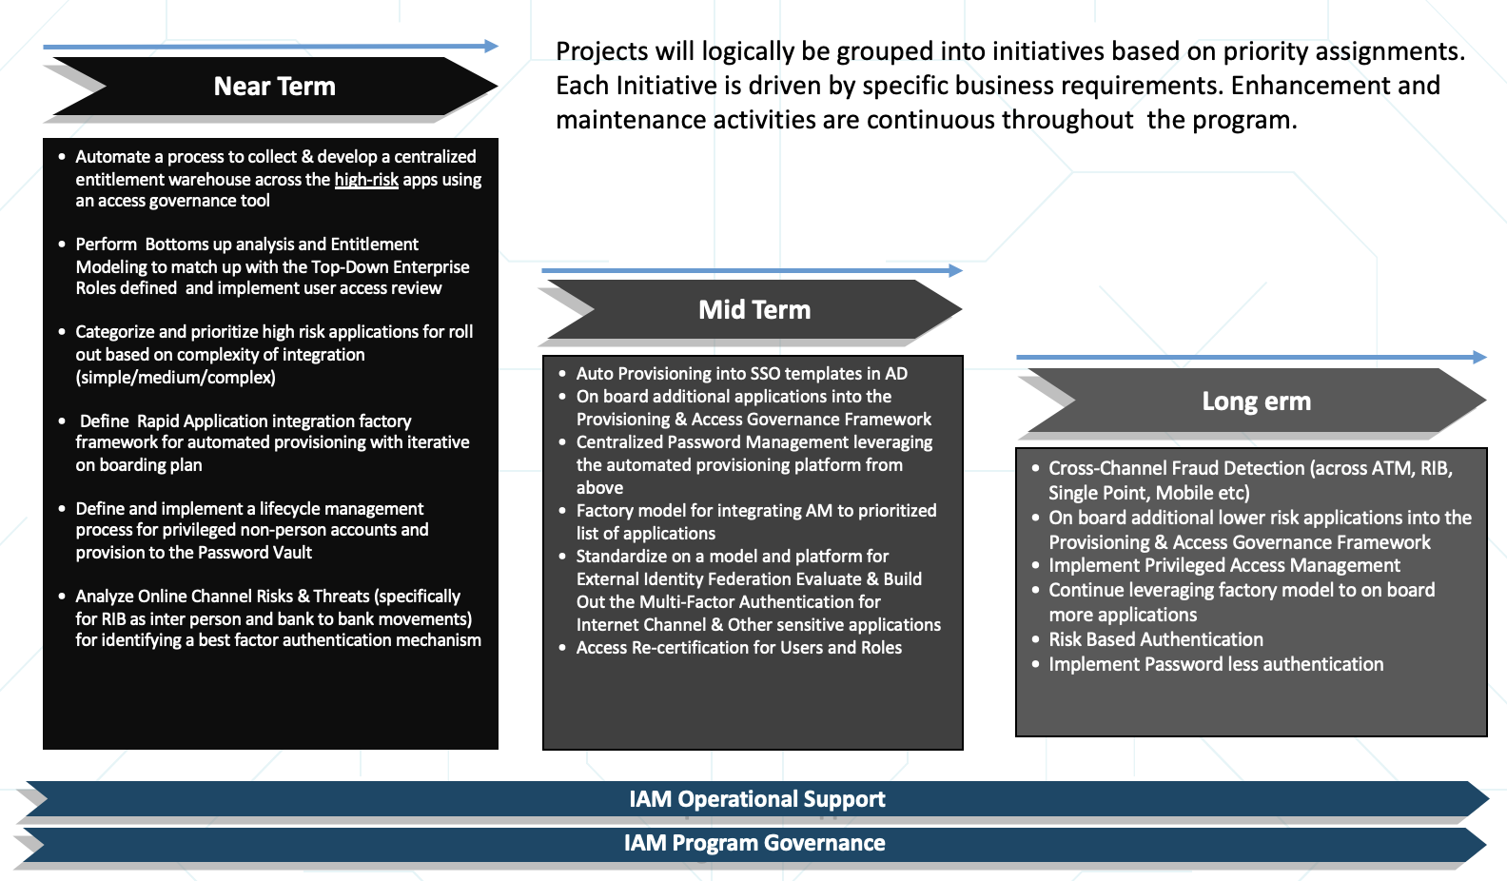
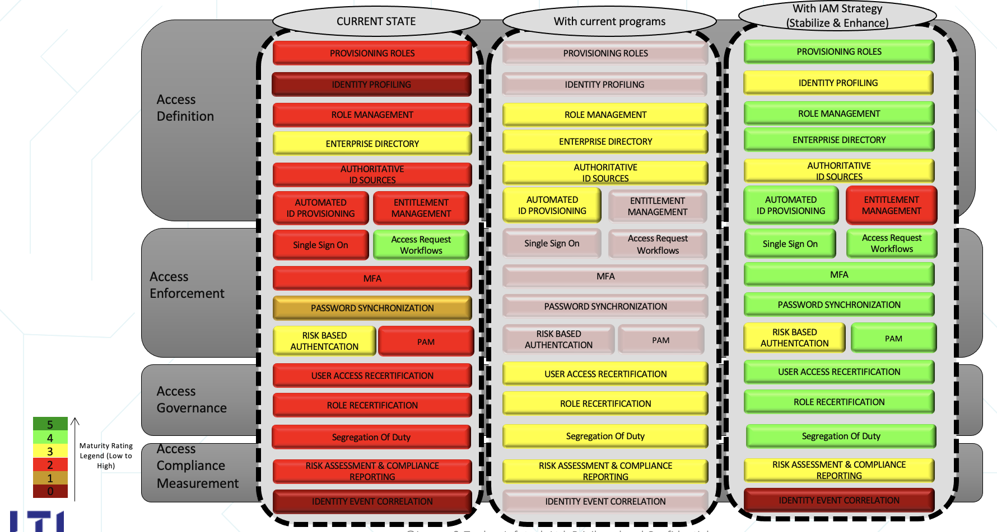
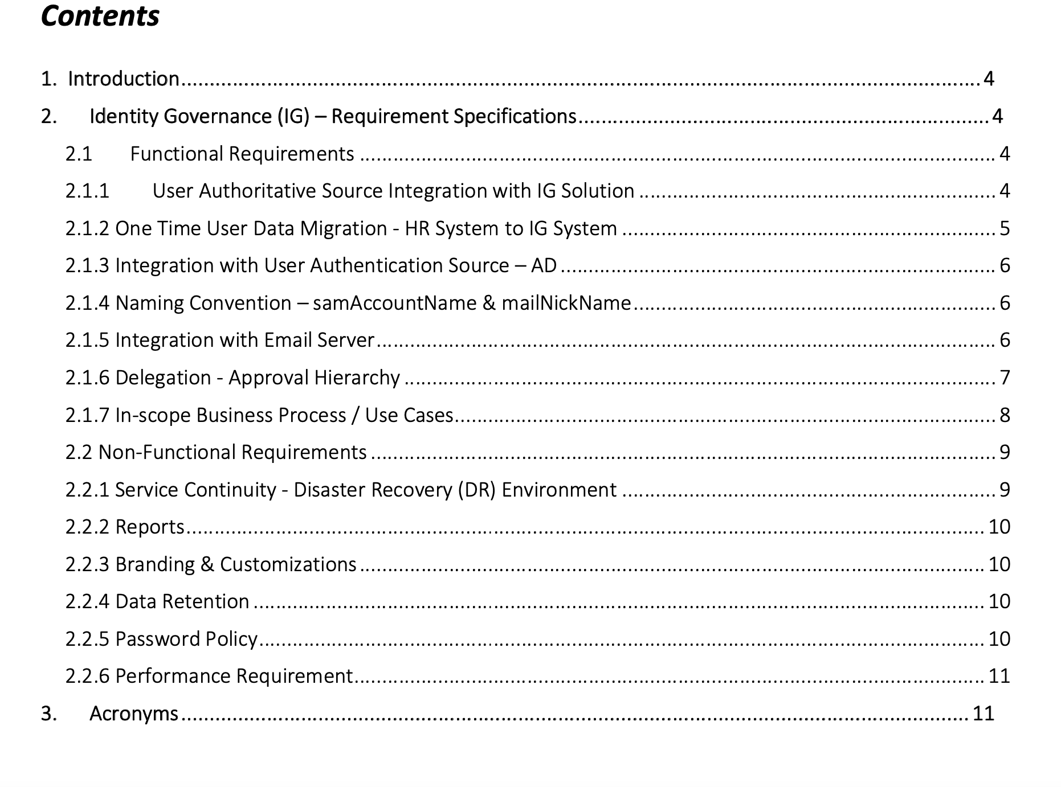
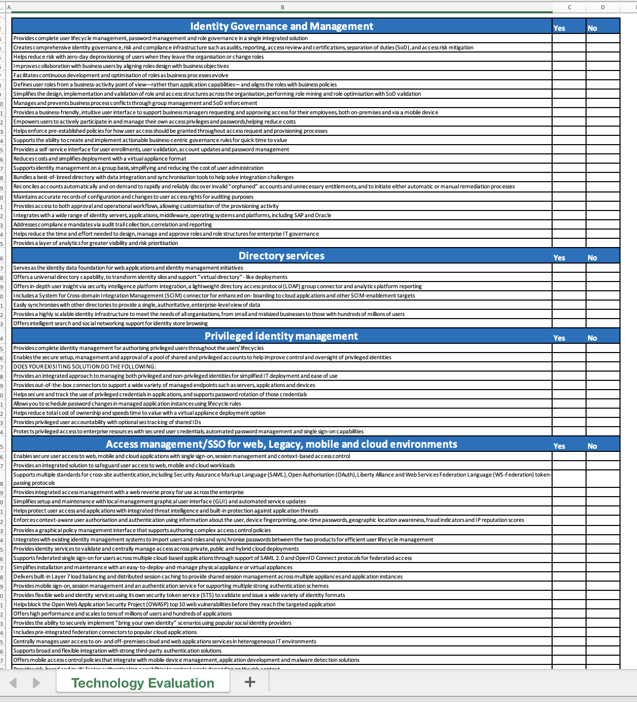
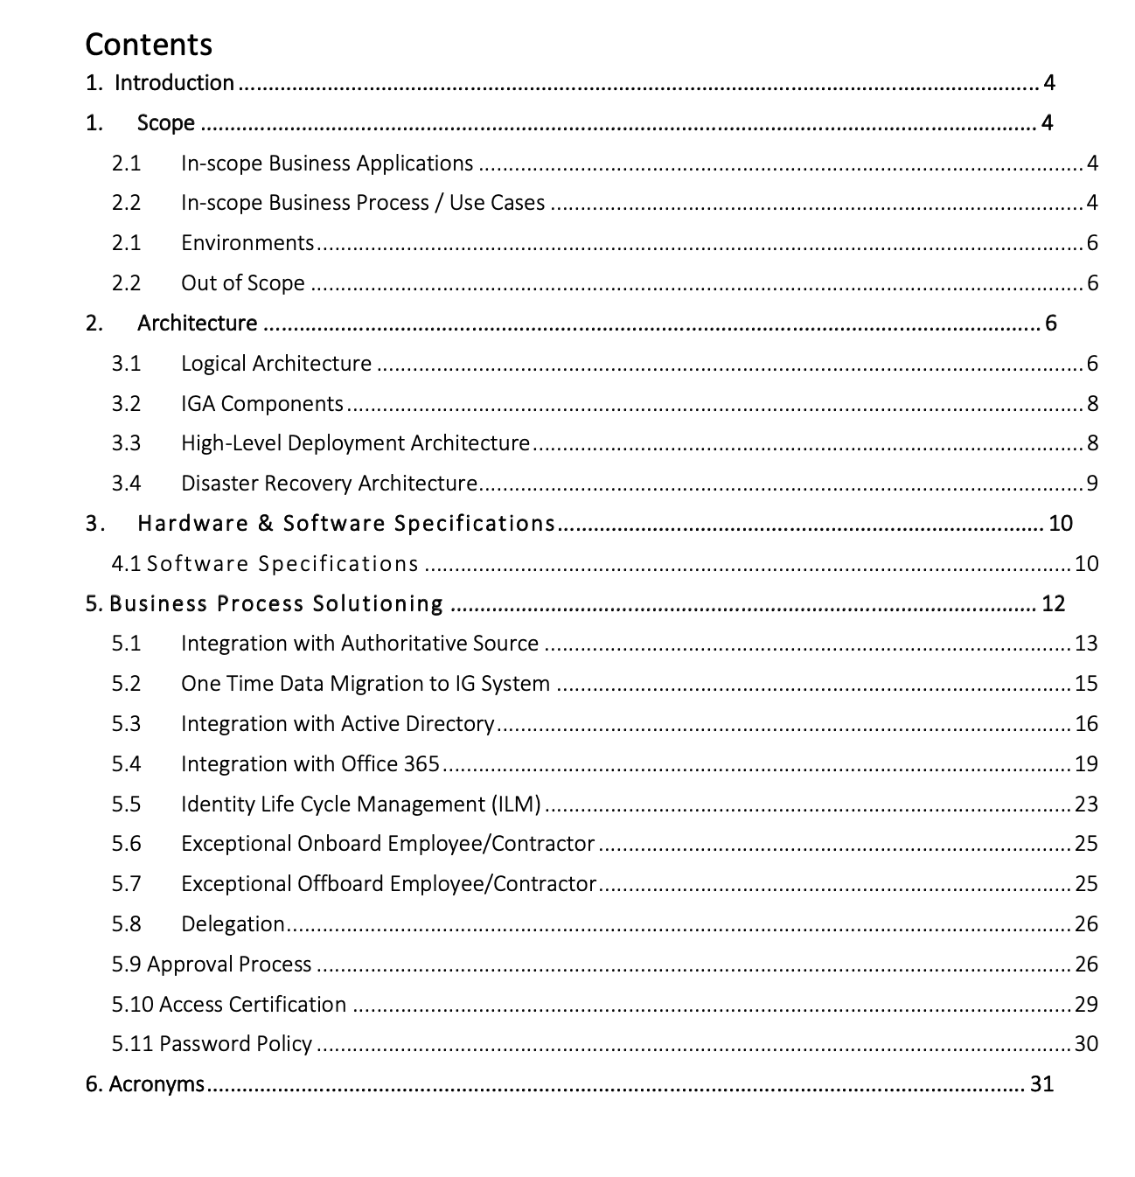
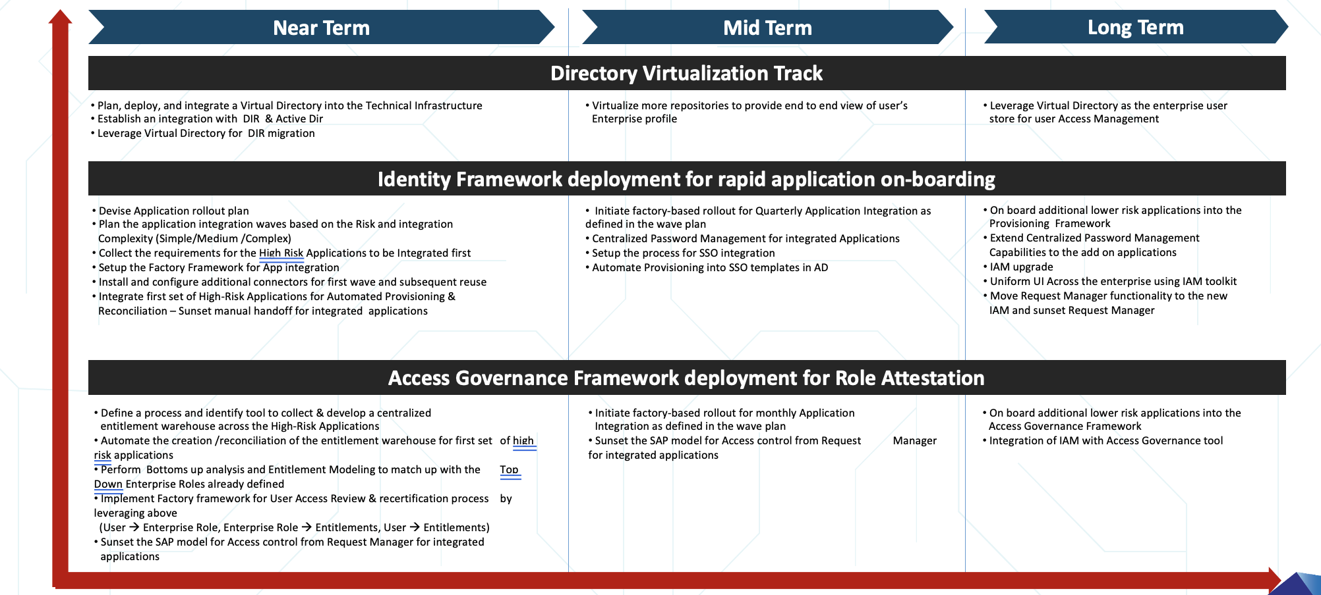
IGA Advisory output sample

Slide 10
LTI - IGA Advisory/Assessment Package
GOLD
DIAMOND
PLATINUM
4 weeks, with 2 IAM SME
8 weeks, with 2 IAM SME
12 weeks, with 2 IAM SME
$26,000.00
$51,000.00
$79,000.00
50 applications assessment
Current state
Gap Analysis
IGA program Roadmap
Application Categorization and Integration Approach
Technology evaluation checklist
100 applications assessment
Current state
Gap Analysis
IGA program Roadmap
Application Categorization and Integration Approach
Business & Technical Requirements for the IAM Program
Outcome
Current state
Gap analysis
Roadmap plan
Requirements Spec
200 applications
Current state
Gap Analysis
IGA program Roadmap
Application Categorization and Integration Approach
Technology evaluation & Recommendation
Business & Technical Requirements for the IAM Program
Outcome
Current state
Gap analysis
Roadmap plan
Outcome
Current state
Gap analysis
Roadmap plan
Provide the Risk based governance service
Provide least privilege assessment on applications
Self Service configuration for Identities

Slide 11
IDAM Suite - Solution Offering

Slide 12

















LTI Integrated IDAM Solutions
Identity
IGA
Applications
Access
Central Repository for
Identity
Target application Reconciliation
RBAC/ABAC/PBAC
Who has what access
Access Control
Authorization
Authentication
MFA
Adaptive Risk
Secure Privleged Access
Password Vault
Session recording
JIT Access
Secure remote Access
EPM
Identity Governance & Administration
SSO/
Access Management
PIM/PAM

Slide 13




LTI Integrated IDAM Solutions
Identity
Applications
IGA
IGA
Access
Central Repository for
Identity
Target application Reconciliation
RBAC/ABAC/PBAC
Who has what access
Access Control
Authorization
Authentication
MFA
Adaptive Risk
Secure Privleged Access
Password Vault
Session recording
JIT Access
Secure remote Access
EPM
Identity Governance & Administration
Access Management, MFA
PIM/PAM

Slide 14
LTI – IDAM standalone Services offering by LTI PS team
LTI has dedicated world class professional service team to take care of IDAM implementation, below are the IDAM standalone solution which LTI offer
PIM/PAM
Secure Privileged Account and IT resources
IDM+IGA
User Lifecycle Management and Access Governance
Access Management
CIAM
Federation & SSO, MFA
Consumer Identity and Access management needs a separate and dedicated attention

Slide 15
LTI IGA Implementation- Professional Services

Slide 16
IDM+IGA Solution feature – High Level
IGA Features
Connected Applications and Automation | Governance and Attestation | Automated Access Control | Centralized Approval | Reporting & Dashboard
Self Service
Automation (annual review)
User-Access Re-Certification
Orphan accounts Remediation
SoD Automation for Exceptional Access control
Reports & Dashboard
Un-Authorized Access remediation automation
RBAC
ABAC
PBAC
Approval workflow
SoD / Sensitive Access
Automated Notifications
Common policies (Naming, Password policies etc)
LCM reporting
Risk reporting
Exceptional access reports
Password Policy violation reports
SoD violation reports
Re-Certification reports
Customized Dashboard for VIP users
HR source of Truth Integration
Application/Directory integration for Automated Provisioning & De-provisioning
Automation (Joiners/Movers/Leavers)
Birth Rights Automation

Slide 17
SSO/Federation + MFA Solution feature – High Level
SSO Features
Intelligent Authentication | Centralized Access and Session Management | Identity Federation | User Services | Auditing & API Support
Centralized and distributed authorization
Supports web application, thick clients, mobile devices, APIs, services
Supports single session across
Stateless sessions
Session blacklisting/Whitelisting
Share identity information across different organizations
Utilizes open standards such as OAuth2.0, SAML2.0, WS-Federation, WS-Trust, ADFS
Supports cloud and mobile use cases
Single logout across the applications
Provides user self registration UI
Self password reset
User privacy and consent management
Fined grained delegation and consent
Resource Sharing
Extensive activity, authentication, access auditing
Supports various audit event handlers viz, Splunk, JSON, CSV, Syslog, JDBC, JMS
Tamper Event Logging
Blacklist and Whitelist fields
Extensive customization through REST APIs
SSO/CDSSO
Fine grained authentication
Social Authentications using well known providers
MFA using Web-authentication, Push notifications, HMAC and time based OTP authentication
Password-less, Biometric and behavioural logins
Adaptive risk based authentication

Slide 18
PIM/PAM Solution feature – High Level
PIM/PAM Features
Integrated Systems | Password and Session Management | Supported Platform | Policies and Security | Reporting & Dashboard
Windows Active Directory
SSO Integration
IDAM Integration
Email Server
Privileged Password Management
Privileged Session Management
Service account Password management
Web Application Session Management
Network Devices Password Management
Database password Management.
Privileged Remote Access
Windows
Linux
Oracle
SQL
Sybase
Mongo DB
Network Devices
Web application
Access policies
Connection profiles for lateral movement and suspicious activities
Session Recording
Enhanced Session Auditing with key strokes and windows title detection
Session Auditing
Multi level Approval workflow to privileged account and systems
DSS Key Management
Account Password Age
Smart Rule Details
Entitlement report
Password Activity
Session Activity
Password Release Activity
Admin Session Activity

Slide 19



Enterprise PIM/PAM As a Service
Privilege Password Management
Endpoint Privilege Management
Secure Remote Access
Discover, manage, audit, and monitor privileged accounts
Manage privileges on Windows, Mac, Linux, and Unix endpoints
Centrally manage and secure remote access for service desks and vendors
Secure Password Safe
Cloud Vault
DevOps secure Safe
Windows and Mac
Unix and Linux
Active Directory Bridge
Remote Support
Privileged Remote Access
Safe lets you reduce the risk of privileged credential misuse through automated password and session management. Cloud Vault offers essential vaulting capabilities in the cloud. And DevOps Secrets Safe lets you secure and manage secrets used in DevOps environments.
Stop malicious attacks, including malware and ransomware, by assigning just-in-time privileges and controlling applications on Windows, Mac, Unix, Linux, and networked devices - all without hindering end-user productivity. Plus, bridge the gap between Windows and other operating systems by extending Active Directory’s Kerberos authentication and single sign-on (SSO).
With Remote Support, it empowers the service desk to support Windows, Mac, Linux, iOS, Android, network devices, and peripherals with one, secure tool. Privileged Remote Access allows you to secure, manage, and audit vendor and internal remote privileged access without a VPN.

Slide 20
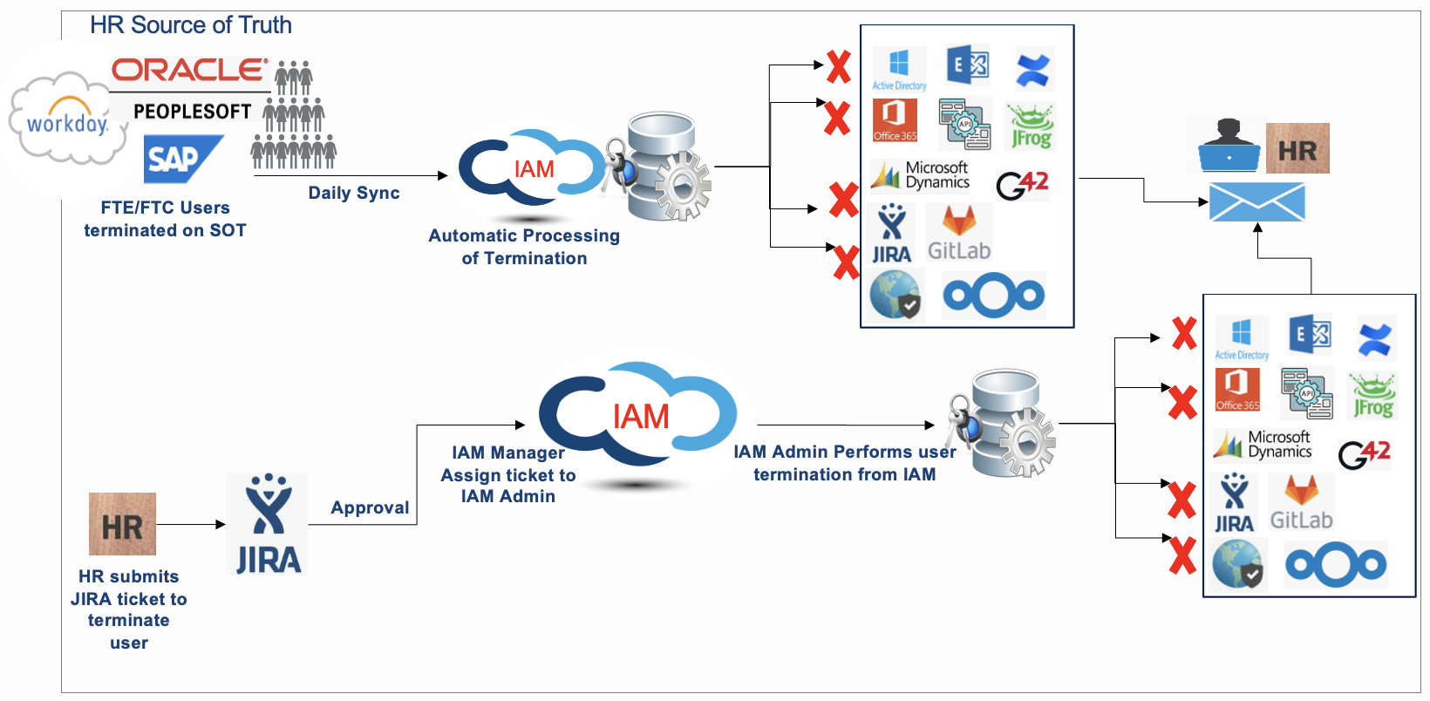
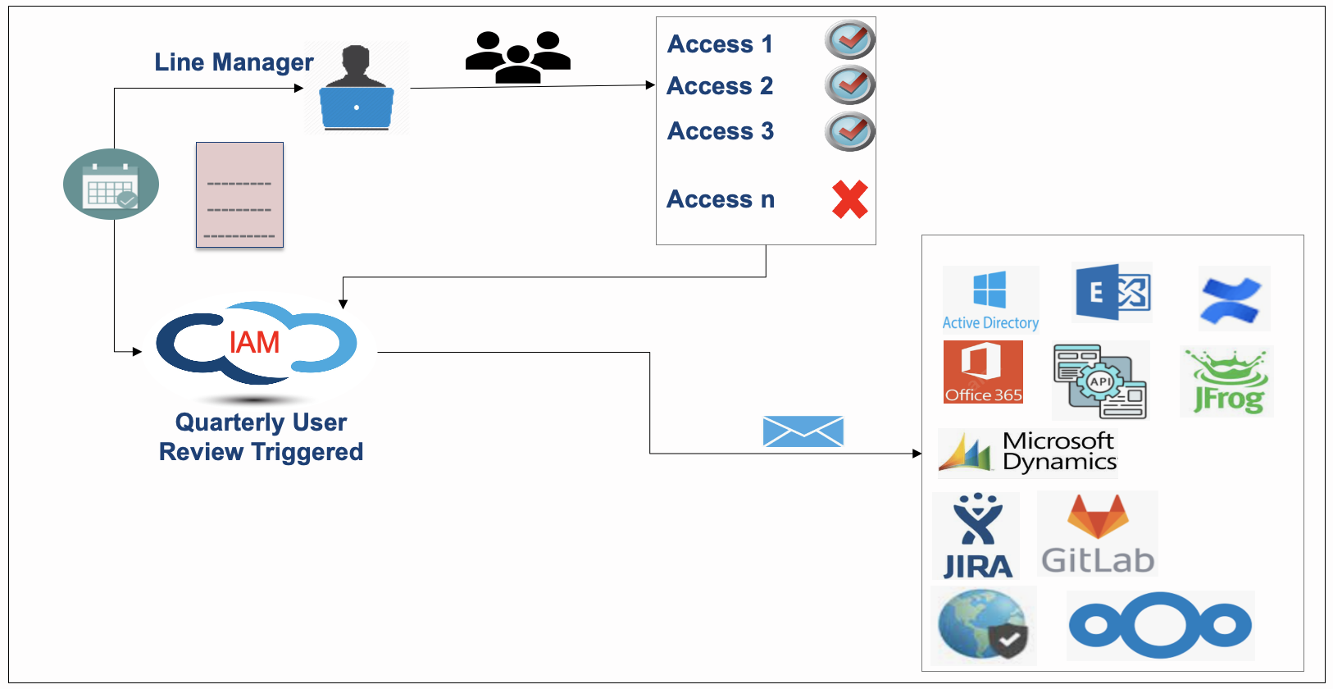
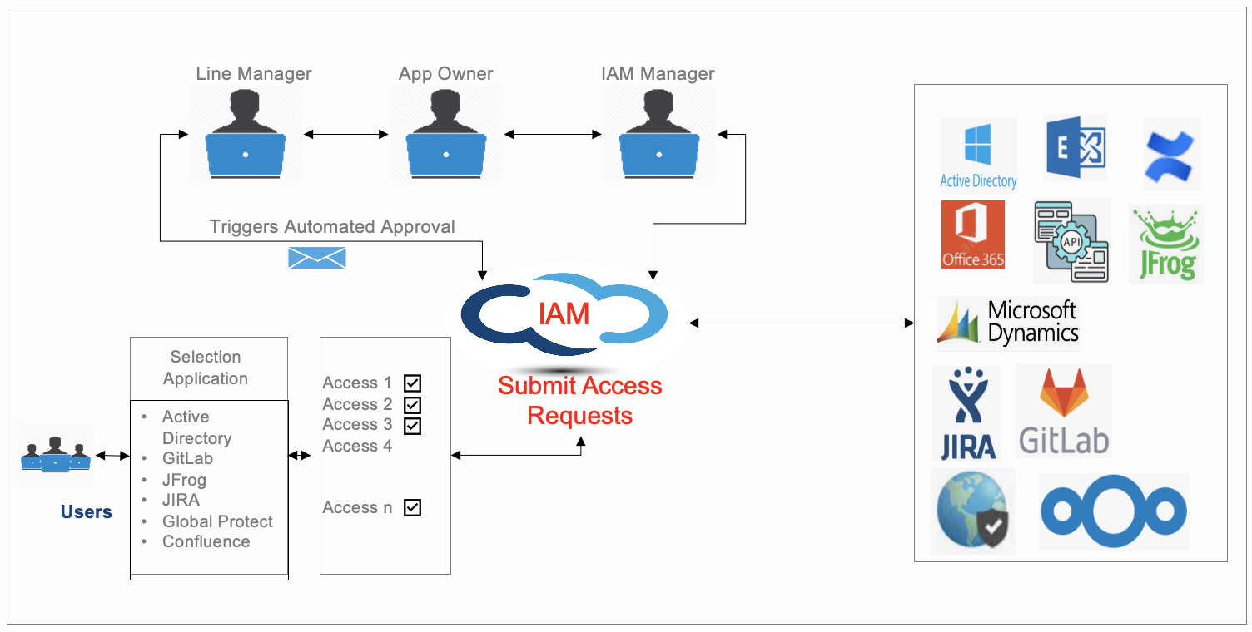








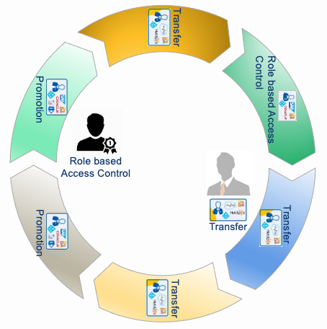
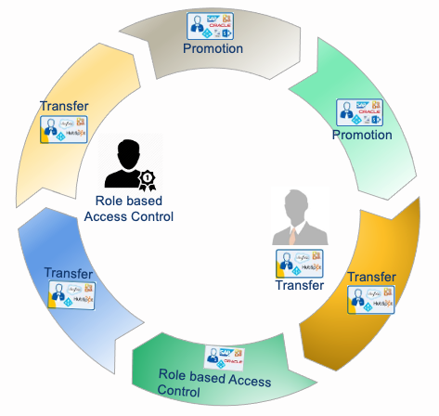



LTI IGA - User Journey Overview – High Level
Self Service,
User attribute sync, Password Reset
IGA-
User Access
Re-Certification
Rules and Policies Automation, RBAC, ABAC, PBAC
Employee Creation in HR
Birth Right Automation
User
Termination
Automated notification
IGA
Employee Exit
De-Provisioning
New User
On-Boarding
Daily Sync of Users Identity
HR Source of Truth
Legacy
Applications
On-Prem Applications
Cloud Applications

Slide 21
LTI-IGA Solution Implementation Sequence
Deployment and Basic Setup (On-Premise/Cloud
User Attribute Finalization, HE system integration
Design Template for User on-boarding.
Joiners
Movers
Leavers
Common Naming Policies, Email Notification Templates, SMTP Configurations etc.
Define Authoritative source for user login to IDAM system by connecting to Directories
Base IGA setup
& Implementation
User Re-Certification Configuration based on Business requirements for each apps.
1
Deployment and Setup
Unified Users Collection through HR Integration
Common Template, Approval, Rules and Policies
SMTP/Email Notification template
Orphan Account Re-Certifications process configurations to identify orphan account, & mitigate them
IGA
Configuration
Apps Integration
2
3
Bucketize the Applications into Different Categories Simple, Medium, Complex.
Checkout applications and define connectors for Automated Provisioning and De-Provisioning
Building Audit & Compliance system. Reporting and Dashboard for different Stakeholders
Connector pattern
Account correlation data
Entitlement, Role Management
Entitlement ownership
Fulfilment workflow pattern(s)
Naming Policies,
Password Policies
Who has access to what
User Re-Certifications
Orphan Account Management
Approval & Audit Compliance
Segregation of Duties
Reports and Dashboard
Naming Policies, Entitlement Layer, Rules, Ownership configuration, Role Mining etc.
Fulfilment Workflow, Approval Workflows, Custom logic building, Notification configuration
SODs for within Application, for Makers and checkers,
SOD across applications

Slide 22

Identity and Access Attestation – IGA
Continuous Control
Monitoring
Intelligent Access
Request / Review
Application
SoD Management
Role/Privilege/Policy
Design & Management
Data Access
Governance
Privilege Account
Governance / Monitoring
Infrastructure Access
Governance
Usage, Peer and
Behavior Analysis
Identity Governance and Administration
B2E
Users
Cloud or On-Prem Managed Platform
Who has access to what ?
What does the access secure ?
What are they doing ?
360°
View of Security
Identity
Access
Entitlement
Control
Data
Usage
Audit
Risk
Event
Configuration
Cloud
Governance
Infrastructure
Governance
Application
Governance
Data
Governance
Notes:
• Who has access to what – implementing purpose-built deep integration connectors for Cloud and enterprise applications/platforms
• What does the access secure – identifying what type of data (e.g., PCI, PHI, financial, and sensitive), business functions, and/or infrastructure does the user have access to and what can they perform with that access (e.g., modify, read-only, and delete)
• What are they doing with their access – collating and analyzing usage and audit logs from managed platforms, log aggregators, etc

Slide 23
IGA – Integrated Architecture

Slide 24























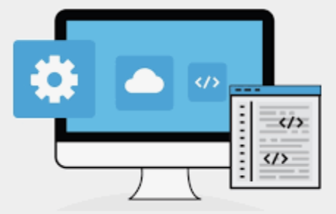
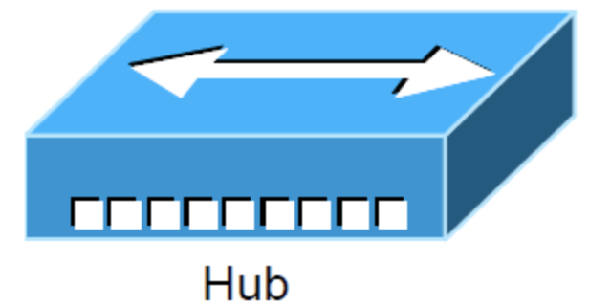

IDAM High Level Integrated Architecture
IGA
Email Notifications
Flat files
API
JDBC
Customer End User
IGA
Admin
Service
Portal
Identity Governance
HR Feeds
Launch IDAM
Request Access
Audit & Compliance
Privilege Recertification
Trusted HR Source(s)
SAML,
OAuth
Open ID
WS Federation
Revoke Access
Privileged Users
Access Provisioning
Application On-boarding
Access Review
Users
Password Mgmt
Campaign
Identity Protection
Update Profile
Reports
Auditors
SSO Console
Terminate Profile
Identity
Provisioning
Employees
AD/AAD
Rejection Email
Authentication
Manager
Reject
Approve
Users
Recertification
IDAM Tool DB
Escalator
Primary
Approver
PIM/PAM
Applications
Notes:
Customer User Type
Access Manager (SSO)
Service Portal for Access Requests, Re-Certifications, Ad-Hoc User Termination etc.
Identity Management: Role Mgmt., MFA, SSO, Password Management
Approval, Escalations Process
Unified Users Collection to IAM, Data Collections, Provisioning Connectors interface.
Accelerator Common API for connectors to accelerate the APP integrations.
HR System – Source of Truth.
PIM/PAM

Slide 25
LTI PAM As a Service

Slide 26
LTI IGA-Centre of Excellence

Slide 27
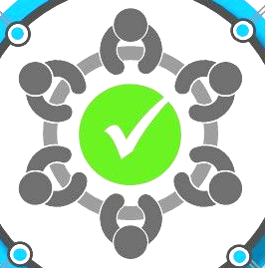
LTI – IDAM Centre of Excellence
Domain Expertise
LTI has many skilled resources, who has strong experience in providing customer services/support.
Knowledge and Skill management
Planning
Decision-making
Problem-solving
Motivating
Best Practices and Standards
LTI is following known method, techniques or proven processes used to achieve an end goal.
Training Program
LTI has been regularly providing training on IDAM tools as per customer demand or market trend and help team obtain certification either through our OEM vendor or from external agencies
Re-usable components
LTI is developing documents on 100+ custom connectors, re-usability which is planned to put for customer service to achieve the goals faster.
Certification Program
LTI has regular drive for certification program for different IDAM tool post training as per market trend and keep resources up to date.
Standard Template Creation
LTI has created required templates to execute the project with quality, which is used for all projects.
Notes:
Work in progress slide

Slide 28
LTI – IDAM Centre of Excellence
Domain Expertise
LTI has many skilled resources, who has strong experience in providing customer services/support.
Knowledge and Skill management
Planning
Decision-making
Problem-solving
Motivating
Best Practices and Standards
LTI is following known method, techniques or proven processes used to achieve an end goal.
Training Program
LTI has been regularly providing training on IDAM tools as per customer demand or market trend and help team obtain certification either through our OEM vendor or from external agencies
Re-usable components
LTI is developing documents on 100+ custom connectors, re-usability which is planned to put for customer service to achieve the goals faster.
Certification Program
LTI has regular drive for certification program for different IDAM tool post training as per market trend and keep resources up to date.
Standard Template Creation
LTI has created required templates to execute the project with quality, which is used for all projects.
Notes:
Work in progress slide

Slide 29
LTI Execution Methodologies

Slide 30
LTI IDAM Program Delivery Approach
Phase 1 – Assessment
Workshop
Phase 2 – Requirement and new tool deployment
Phase 3 – Application Integration, Access Review & UAT
Phase 4 – Cutover Migration, Demo
Phase 5 – Go-Live & Warranty Support
Phase 1
Phase 2
Phase 3
Phase 4
Phase 5
IAM Assessment Workshop
IAM Requirements Sign off
Integral Testing
& UAT
Cutover
&
Go-Live
Design & Implementation
Pre-Requisites Handover
Analysis of current environment
Workshop
Gap Analysis
Verify Scope and Business Requirements
Infrastructure Requirements
Application Assessment, Filled Template collection from application owners
Requirement of IDAM/PAM
Requirement Sign Off
Roadmap and use case documents
Implementation of IDAM/PAM signed off requirements.
Application integration
Connectors configuration for automated provisioning and De-provisioning
Email template for different communications
Unit and integration testing
Demo to customer stakeholder(s)
Test case preparation and Assisted UAT with customer
UAT Sign Off
Plan the cutover and Go-Live
Communication between customer and LTI Stakeholders
Post Go-Live warranty support
Transition to Run team.
Enable Run team for steady state support.

Slide 31
LTI IDAM operations Methodology and Approach

Slide 32





LTI Proven transition methodology to successful knowledge acquisition
1 Weeks
5 Week
7th Week Onwards
Pre Transition
Transition Planning
Transition Execution
Operate
Validate in-scope IDAM landscape
Pre-KT Sessions
Calibration
Ground
Work
Identify IDAM SMEs
Knowledge
Capture
Shadow Activities
Reverse Shadow
- Primary
Ownership
Risk Profiling
Change
Management
“Focus on Knowledge acquisition”
“Practice actuals”
Ongoing
Ownership
Identify current Metrics
Schedule Finalization
“Readiness to take over”
“Continuous improvement”
Knowledge Transition
Exit Checkpoints
Multiple levels of certification, Q&A
KCD Sign-off
Scorecard-based Evaluation
Transition
Kickoff
Level 1 Certification
“Ready for
Knowledge Acquisition”
Level 2 Certification
“Ready for Shadowing & reverse shadowing”
Level 3 Certification
“Ready for
Calibration”
Logistics, Staffing, Infrastructure, Contract Management and Process Integration
Publish Transition Workshop calendar
Signed off Transition Plan and Acceptance Criteria
Publish Draft of System Appreciation Documents
Review and Reporting of Mock Requests Handled
Compliance Reports on Tickets handled

Slide 33
BAU Approach for IAM Operations
Push/Pull Alerts, SOP Updates
Ticket Closure and Resolution update
Vendor communication
Delivery Governance
L1
Security Analyst
L2
Security Analyst
L3
Security Consultant
L3.5
Security Consultant
KMDB
CMDB
Corporate users
Incident/Service Request through Service Desk/Email
Formal escalation from L1 to L2/L3 with tracking details ( Via ITSM) for each Escalation
Initial liaison with user, triaging and ticket logging
Ticket tracking and monitor ITSM queue
Incident Management and Resolution
Break-fix, workarounds & resolution updates
Change Impact Analysis, execution & document updates
Ticket escalation to L2 / L3 teams
Monitor Health and Availability
Participate in technical escalations
Support transformation initiatives
Problem Management (Root Cause Analysis)
Device software lifecycle management and recommendations
Performance and Capacity analysis
Configuration and change Management
Vendor coordination for escalated issues
Problem Management (Root Cause Analysis)
Weekly and Monthly Reporting
Team Management
Continuous improvement initiatives
Incident Analysis
Release Management
New Requirements Management & Architecture
Deployment of enhancements and bug fixes
Design of Enhancements and Bug Fixes
Development of Enhancements and Bug Fixes
Testing

Slide 34
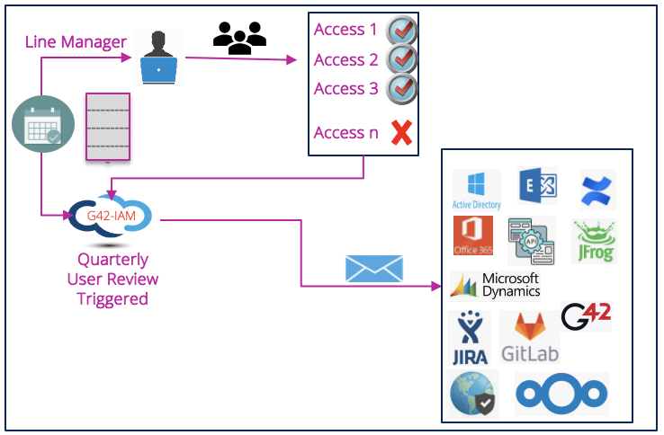
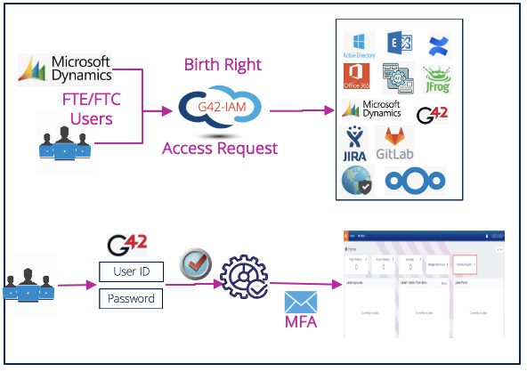
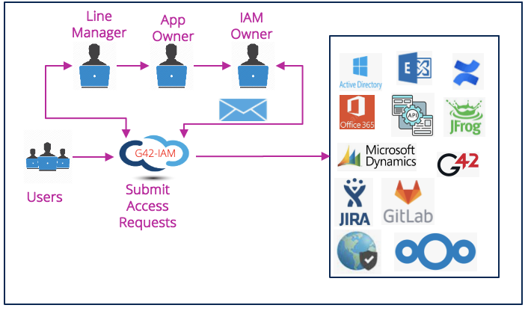
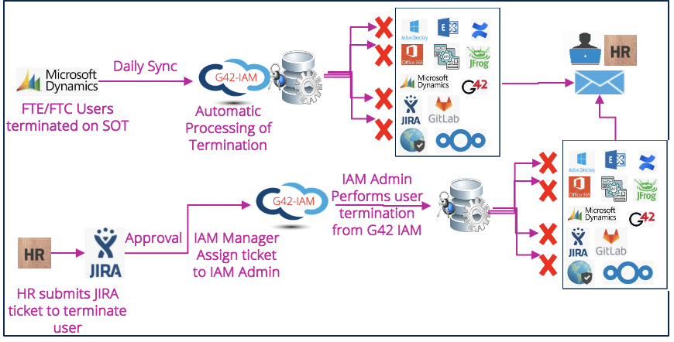

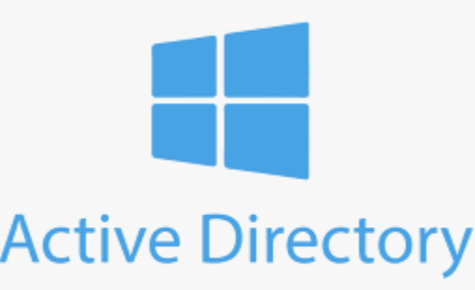





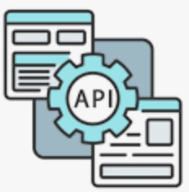




G42 FTE/FTC User Life Cycle Management
AD account and birth right provisioning
ForgeRock AM account and group access
Exchange Mailbox Creation
Jira Account and default access
Confluence Account and default access
Next Cloud default access
Jira ticket automated creation
User Re-Certification
FTE/FTC user Creation in HR-SOT
SSO, MFA
Self Service-Access Request, Password Reset
PAM
Birth Right Automation
User
Termination
Automated notification
Employee Exit
De-Provisioning
G42-IAM
Daily Sync of Users Identity
HR Source of Truth

Slide 35



User Access Request (Manage Access) - Process
Line Manager
App Owner
IAM Manager
Triggers Automated Approval
IAM
Selection Application
Access 1
Access 2
Access 3
Access 4
Access n
Submit Access Requests
Active Directory
GitLab
JFrog
JIRA
Global Protect
Confluence
Users

Slide 36



User Access Review
Access 1
Line Manager
Access 2
Access 3
--------- --------- ----------
Access n
IAM
Quarterly User Review Triggered

Slide 37
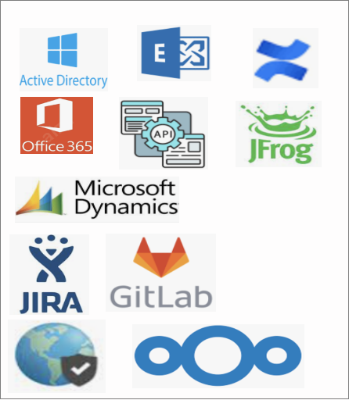
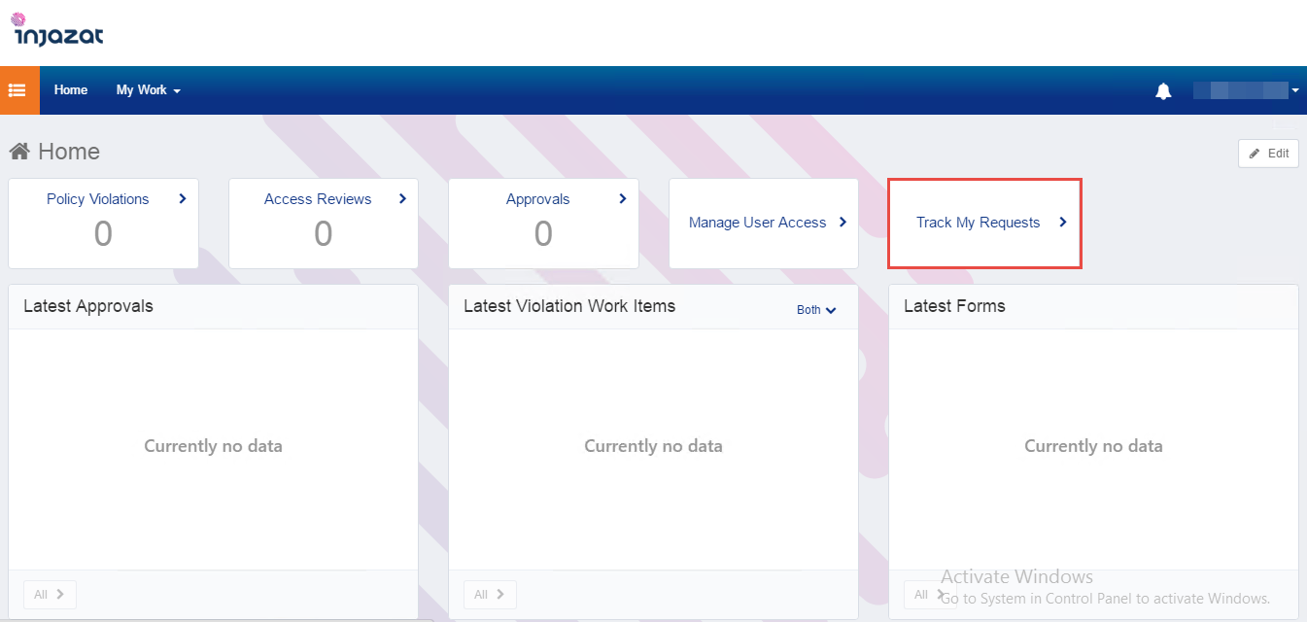
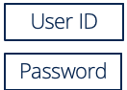
Single Sign On
HR Source of Truth
Birth Right
FTE/FTC Users
IAM
Access Request
SSO
Successful Login
MFA

Slide 38

Leavers/Termination Process
HR Source of Truth
IAM
FTE/FTC Users terminated on SOT
Daily Sync
Automatic Processing of Termination
IAM
IAM Manager
Assign ticket to IAM Admin
IAM Admin Performs user termination from IAM
Approval
HR submits JIRA ticket to terminate user

Slide 39
Joiner
HR
Identity Record:
First Name: John
Last Name: Smith
Phone number
Job Title: Payroll Analyst
Dept: HR
--------- --------- --------- ----------
--------- --------- --------- ----------
--------- --------- --------- ----------
--------- --------- --------- ----------
G42
Identity Management
SSO-Role
Birth Right Access
G42 Access Manager
(Single Sign On)
--------- --------- --------- ----------
--------- --------- --------- ----------
--------- --------- --------- ----------

Slide 40
Movers
HR
Identity Record
First Name: John
Last Name: Smith
Job Title: Finance Manager
Department: Finance
--------- --------- --------- ----------
--------- --------- --------- ----------
--------- --------- --------- ----------
--------- --------- --------- ----------
G42
Identity Management
SSO-Role
Birth Right Access
G42 Access Manager
(Single Sign On)
--------- --------- --------- ----------

Slide 41
Leavers
HR
Identity Record:
First Name: John
Last Name: Smith
Phone number
Job Title: Payroll Analyst
Dept: HR
End Date/Termination Date = Today
--------- --------- --------- ----------
--------- --------- --------- ----------
--------- --------- --------- ----------
--------- --------- --------- ----------
G42
Identity Management
SSO-Role
Birth Right Access
G42 Access Manager
(Single Sign On)
--------- --------- --------- ----------
--------- --------- --------- ----------
--------- --------- --------- ----------

Slide 42
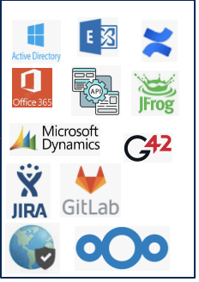
Alternate Leavers/Termination Process
Daily Sync
G42-IAM
FTE/FTC Users terminated on SOT
Automatic Processing of Termination
G42-IAM
IAM Manager
Assign ticket to IAM Admin
IAM Admin Performs user termination from G42 IAM
Approval
HR submits JIRA ticket to terminate user

Slide 43
Solution Benefits
Centralized Identity Repository
Central repository/Single source of truth for all types of users
Central Requesting method for elevated access requests to integrated applications
Central Approval mechanism
Central repository for Audit and Compliance
Achieve Compliance
Report on who has access to what
Ensure people have the right access for their jobs
Monitor and review IAM related controls
Mange Segregation of Duties
Reduce Access Control Risk in the enterprise
Measure IAM related Risk and focus resources on high-risk areas
Implement automated controls to reduce the access control risk of an enterprise
Streamlined Processes
Streamline process for requesting access, access approvals and access certification
Operational Efficiency
Joiner, Mover & Leaver Process Automations
Automated Requests Fulfillment
Risk
Compliance
IAM
Streamlined Processes
Operational Efficiency
43

